Slide 1
CIS CONTROL 16: ACCOUNT MONITORING & CONTROL-I
ACCOUNT MONITORING & CONTROL

Slide 2
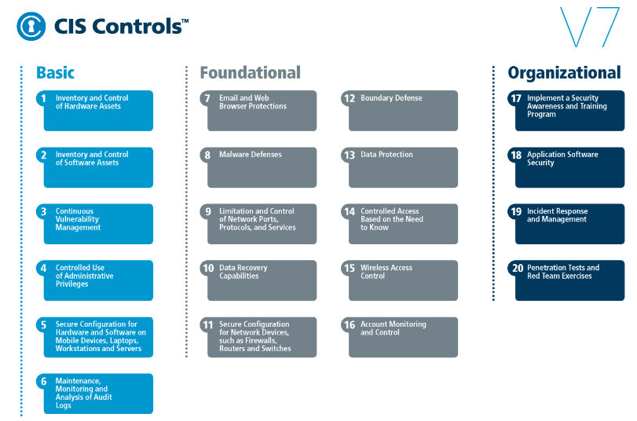
CIS CONTROL 16: ACCOUNT MONITORING & CONTROL-I
https://www.cisecurity.org/controls/

Slide 3
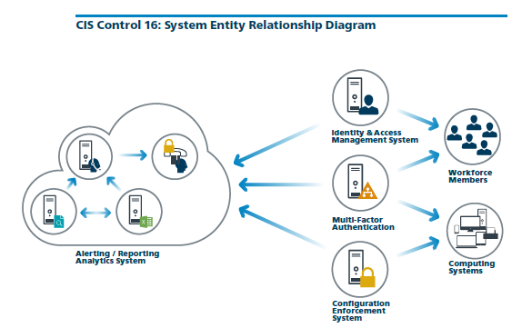
CIS CONTROL 16: ACCOUNT MONITORING & CONTROL-I
https://www.cisecurity.org/controls/

Slide 4
CIS CONTROL 16: ACCOUNT MONITORING & CONTROL-I
16.1: Maintain an Inventory of Authentication Systems
Maintain an inventory of each of the organization's authentication systems, including those located onsite or at a remote service provider.

Slide 5
CIS CONTROL 16: ACCOUNT MONITORING & CONTROL-I
16.2: Configure Centralized Point of Authentication
Configure access for all accounts through as few centralized points of authentication as possible, including network, security, and cloud systems.

Slide 6
CIS CONTROL 16: ACCOUNT MONITORING & CONTROL-I
16.3: Require Multi-factor Authentication
Require multi-factor authentication for all user accounts, on all systems, whether managed onsite or by a third-party provider.

Slide 7
CIS CONTROL 16: ACCOUNT MONITORING & CONTROL-I
16.4: Encrypt or Hash all Authentication Credentials
Encrypt or hash with a salt all authentication credentials when stored.
END

